Slide 1
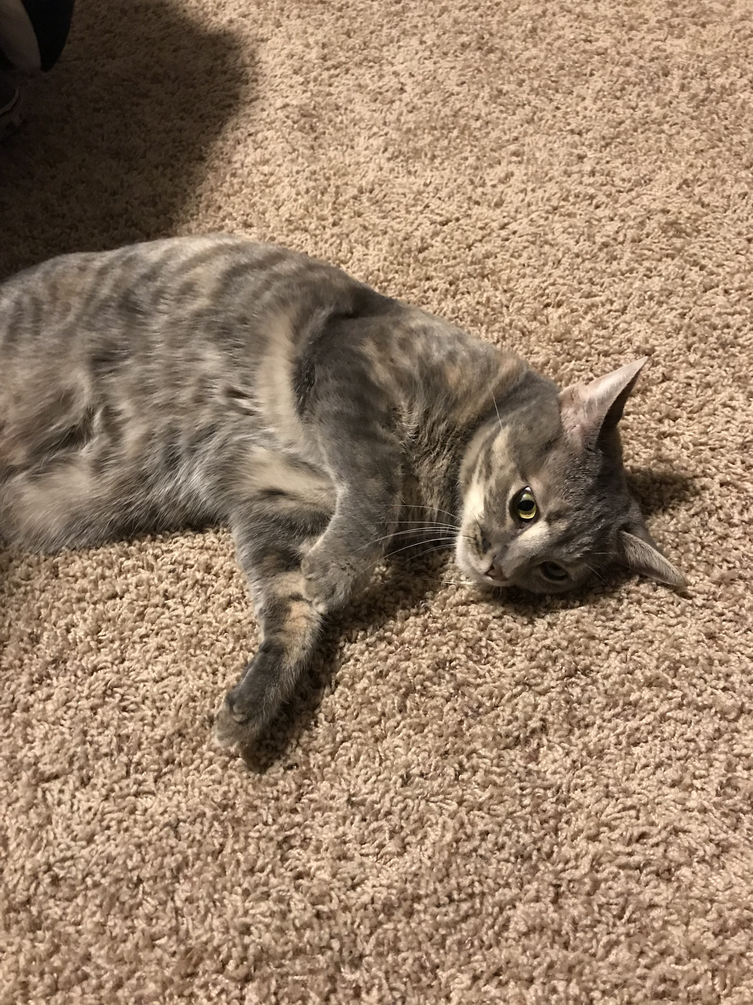
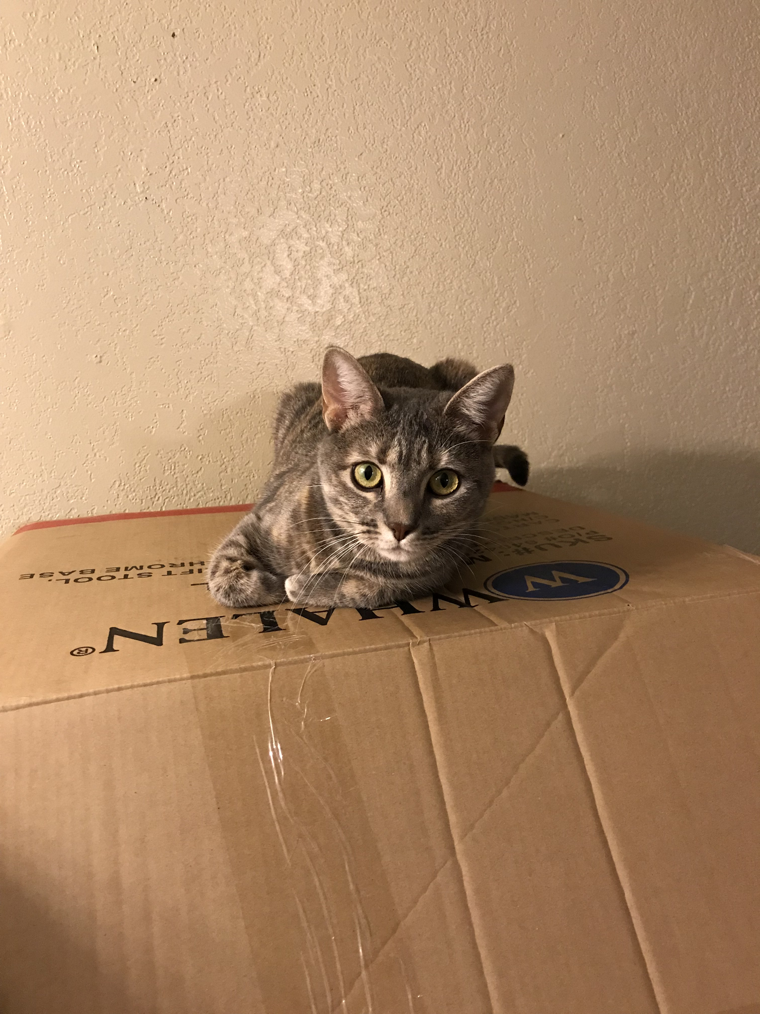
Fourier analysis of cats
By: Taylor Larrechea

Slide 2
Aim of Project
To see if there was anything that could be deducted about the sounds that cat’s make depending on mood.
The main sounds that were used in this project were a cat purring, cat meowing, and a cat screeching.
All techniques used can be found in, “Elementary Fourier Analysis” by Phil Gustafson. [3]

Slide 3
Techniques used
The main techniques used on the soundwaves are as follows;
audioread(‘audio.wav’)
BandPass(x,sr,domfreq,BandL,BandR,PlotL,PlotR)
BandStop(x,sr,domfreq,BandL,BandR,PlotL,PlotR)
SoundWaveTimeFreq(x,sr,TZL,TZR,FZL,FZR)
SpectrogramPlot(z,sr,ymax)
All commands can be found in “Elementary Fourier Analysis” [3].

Slide 4

Cat purring soundwave
The first soundwave was from a cat that was purring. The following table depicts the commands used to generate the time and frequency domain plots of “bellapurring.wav”. This soundwave was recorded in person.
Input Commands
>> [x,sr]=audioread('bellapurring.wav'); >> SoundWaveTimeFreq(x,sr,4.23,4.33,1,500) >> sr sr = 44100 >> N=length(x) N = 580607 >> T=N/sr T = 13.1657

Slide 5
Cat Purring Soundwave Cont.
The following figures are from the Cat purring’s time and frequency domain plots.
Time and Frequency Domain Plots

Slide 6
Cat Purring Soundwave Cont.
Here are the techniques used for BandPassing the cat purring soundwave.
First BandPass of Cat Purring
>> [x,sr]=audioread('bellapurring.wav'); >> BandPass(x,sr,100,1,200,1,600)
From the first BandPass, there is little sound that remains when the lower frequencies are BandPassed.

Slide 7
Cat Purring Soundwave Cont.
The same soundwave was BandPassed again but at a different frequency range.
Second BandPass of Cat Purring
>> [x,sr]=audioread('bellapurring.wav'); >> BandPass(x,sr,50,300,600,1,600)
This time when the same soundwave has the higher frequencies BandPassed, it sounds muffled.

Slide 8
Cat Meowing SOundwave
The second soundwave examined in this project was from a cat meowing. This was hard to get a recording of in person so this soundwave was found from an online resource. The following table shows the commands used to generate time and frequency domain plots. [1]
Input Commands
>> [x,sr]=audioread('catmeow.wav'); >> SoundWaveTimeFreq(x,sr,0.2,0.21,500,700) >> sr sr = 11025 >> N=length(x) N = 8928 >> T=N/sr T = 0.8098

Slide 9
Cat Meowing Soundwave Cont.
The following table has the time and frequency domain plots from the cat meowing soundwave.
Time and Frequency Domain Plots

Slide 10
Cat meowing soundwave Cont.
Here now the Band Pass filter is used on the cat meowing soundwave.
FBandPass of Cat Meowing Soundwave
>> [x,sr]=audioread('catmeow.wav'); >> BandPass(x,sr,1100,1200,1300,1000,1400)
When the same soundwave is BandPassed at higher frequencies, the soundwave then sounds like
a high pitched echo.
[2]

Slide 11
Cat Meowing Soundwave Cont.
This time the same soundwave was BandPassed but at lower frequencies. and this time it sounds different.
BandStop of Cat Meowing Soundwave
>> [x,sr]=audioread('catmeow.wav'); >> BandPass(x,sr,540,1,1000,1,1000)
Here the soundwave resembles more of what the original soundwave was.

Slide 12
Mad Cat Soundwave
This soundwave is of a cat that is mad or that is very irritated. It is different from the previous two in that it is a combination in sorts of low and high frequencies. BandStopping did not affect the previous two soundwaves but it did affect this one. This soundwave was found from and online resource. [4]
Input Commands
>> [x,sr]=audioread('catscreech.wav'); >> SoundWaveTimeFreq(x,sr,0.4,0.41,1700,1800) >> sr sr = 11025 >> N=length(x) N = 16576 >> T=N/sr T = 1.5035

Slide 13
Mad Cat Soundwave Cont.
Here are the plots of the mad cat soundwave.
Time and Frequency Domain Plots

Slide 14
Mad Cat Soundwave cont.
For this soundwave, BandPassing and BandStoping had slightly different sounds to them compared to the original. The previous two soundwaves did not see much difference in between the original and the BandStopping done on them.
BandPassing of Mad Cat Soundwave
>> [x,sr]=audioread('catscreech.wav'); >> BandPass(x,sr,1700,1,1200,1,1800) >> [x,sr]=audioread(‘catscreech.wav’); >> BandPass(x,sr,1700,1000,1800,1,1800);
Both soundwaves that were produced from the BandPass resemble the original, just with certain
frequencies taken out.

Slide 15
Mad Cat Soundwave Cont.
Here are the plots that are from BandPassing the mad cat soundwave.

Slide 16
Mad Cat Soundwave Cont.
Here the same soundwave is BandStopped. The following table are the commands used.
BandStopping of Mad Cat Soundwave
>> [x,sr]=audioread('catscreech.wav'); >> BandStop(x,sr,1700,1000,1900,1,1900) >> [x,sr]=audioread('catscreech.wav'); >> BandStop(x,sr,1700,1,1000,1,1900)
The BandStopped soundwaves are closer to resembling the original soundwave, but they still seem to
have parts of it that sound different from the original.

Slide 17
Mad cat Soundwave Cont.
Here are the plots of the BandStopped soundwave of the made cat.

Slide 18
All of Processed and original soundwaves
Soundwave | Original | BandPass Low | BandPass High | BandStop Low | BandStop High
Cat purring “bellapurring.wav”
Cat meowing “catmeow.wav”
Mad Cat “catscreech.wav”

Slide 19
Analysis of Results
From the BandPassing and BandStopping that was done on the soundwaves, there are some things to observe.
When cats are happy or neutral, they tend to make little to no sound and if there is sound it usually resides in the lower frequency and softer in tone.
When cats are unhappy or wanting attention, they tend to make sounds that are in the higher frequencies so that it is easier for us to hear.
This analysis is by no means fact rather it is observations and opinions from the results of the soundwaves.

Slide 20
Sources
Works Cited
[1] - Gay, James. Wavlist. 2007. 31 October 2017. <http://www.wavlist.com/soundfx/002/>.
[2] - Get-Sounds. Get Sounds. 7 December 2017. Web Site. 7 December 2017.
http://www.get-sounds.com/snd_list.php?cat=Military.
[3] - Gustafson, Phil. Elementary Fourier Analysis. 2017.
[4] - Wavsource. n.d. 29 November 2017. <http://www.wavsource.com/animals/animals.htm>.

